Slide 1
Sentiment Analysis Using Naive Bayes Algorithm Of The Data Crawler : Twitter
Meylan Wongkar and Apriandy Angdresey
Department of Informatics Engineering
De La Salle Catholic University
Rohan Balasubramanian
1911044
A3

Slide 2
ABSTRACT
Sentiment analysis is an activity carried out to see the level of public sentiment or public opinion relating to goods or services and even a figure, both political and celebrity figures
In this study, a sentiment analysis application for twitter analysis was conducted on 2019 Republic of Indonesia presidential candidates, using the python programming language
There are several steps taken to conduct this sentiment analysis, which is to collect data using libraries in python, text processing, testing training data, and text classification using the Naïve Bayes method.

Slide 3
INTRODUCTION
Sentiment analysis (or opinion mining) is a natural language processing technique used to determine whether data is positive, negative or neutral.
Sentiment analysis is often performed on textual data to help businesses monitor brand and product sentiment in customer feedback, and understand customer needs.
It can also be used to determine the general opinion of the public on the important and trending events occurring in the news with the huge amount of data present in social media.

Slide 4
Sentiment Analysis Algorithms
Rule Based Approach:
A rule-based system uses a set of human-crafted rules to help identify subjectivity, polarity, or the subject of an opinion
These rules may include various NLP techniques like stemming, tokenization, part-of-speech tagging and parsing
Defines two lists of polarized words (e.g. negative words such as bad, worst, ugly, etc and positive words such as good, best, beautiful, etc).Counts the number of positive and negative words that appear in a given text.
If number of positive words > number of negative words : positive sentiment
If number of positive words < number of negative words : negative sentiment

Slide 5
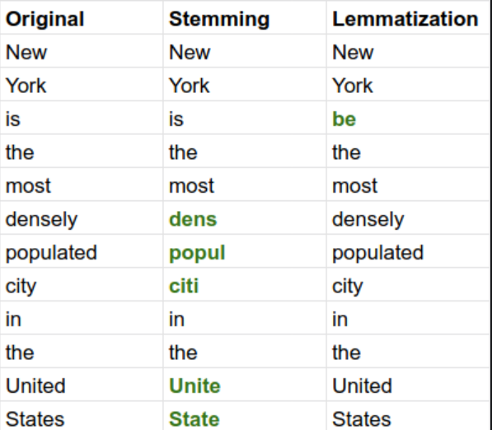
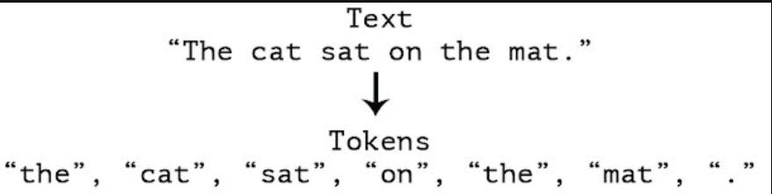
Stemming and Lemmatization
Tokenization

Slide 6
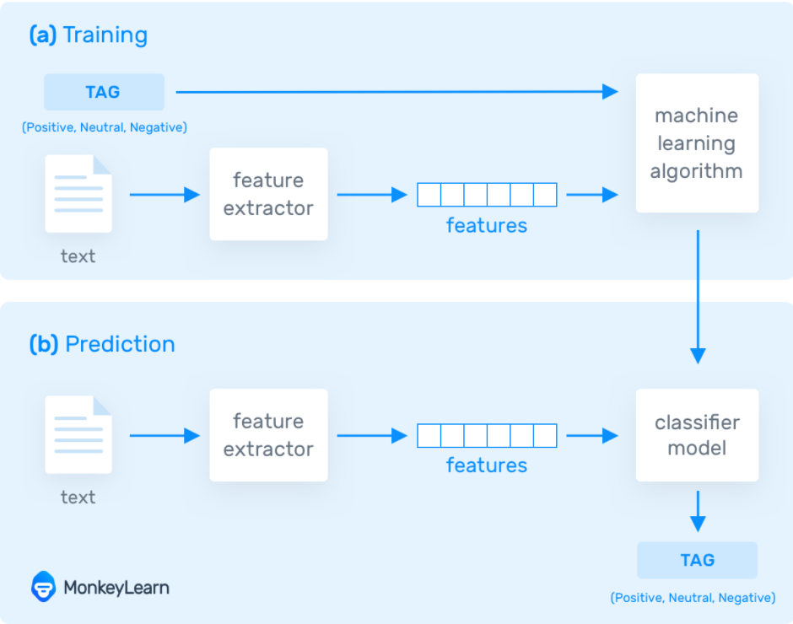
Sentiment Analysis Algorithms
Automatic Approach:
This approach doesn't rely on manually crafted rules, but on machine learning techniques.
In the training process (a), our model learns to associate a particular input (i.e. a text) to the corresponding output (tag) based on the test samples used for training.
In the prediction process (b), the feature extractor is used to transform unseen text inputs into feature vectors. These feature vectors are then fed into the model, which generates predicted tags

Slide 7
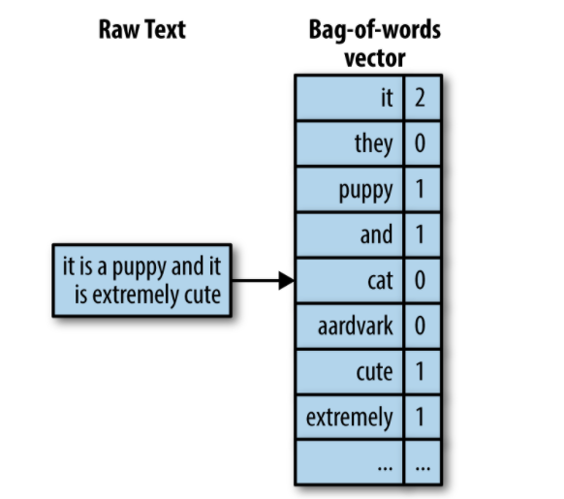
Feature Extraction
The first step in a machine learning text classifier is to transform the text extraction or text vectorization, and the classical approach has been bag-of-words or bag-of-ngrams with their frequency
Bag-of-ngrams along with TF-IDF helps in feature extraction which in turn helps both the training and the prediction model to use a vector representation of the raw text

Slide 8
Classification Algorithms
Naïve Bayes: a family of probabilistic algorithms that uses Bayes Theorem to predict the category of a text.
K-Nearest Neighbor(KNN) Algorithm: K-NN algorithm assumes the similarity between the new case/data and available cases and put the new case into the category that is most similar to the available categories.
Support Vector Machines: a non-probabilistic model which uses a representation of text examples as points in a multidimensional space. Examples of different categories (sentiments) are mapped to distinct regions within that space.

Slide 9
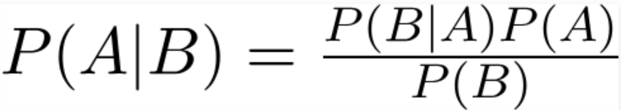
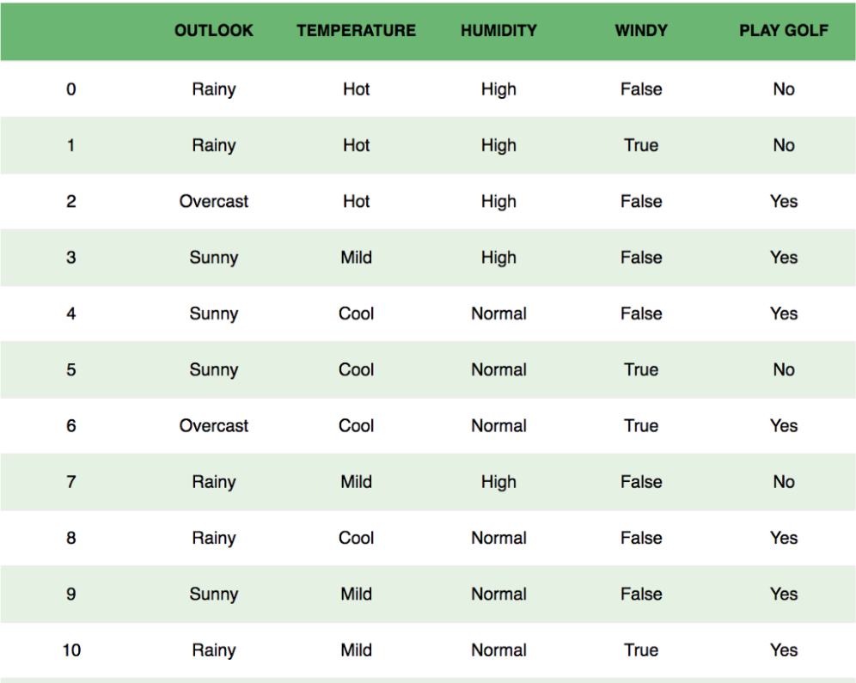
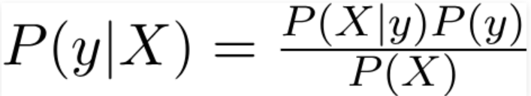

Naive Bayes Classifier Bayes Theorem:
Ex: P(playing golf | features)
Variable y is the class variable(play golf)
Variable X represent the parameters/features
Since the denominator does not change, proportionality can be introduced
Since there are only 2 outcomes possible, yes or no:

Slide 10
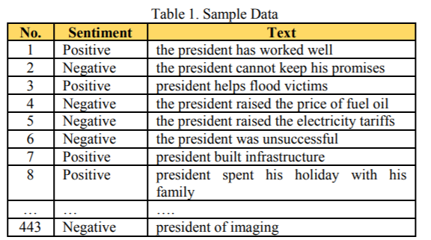
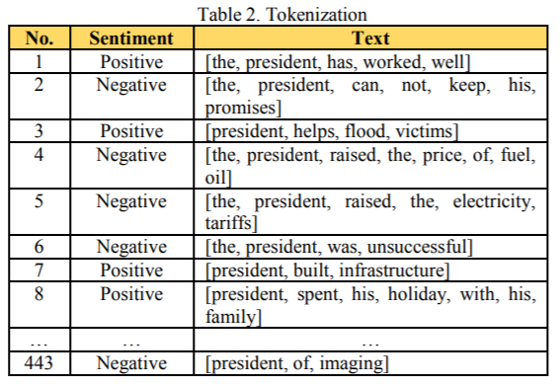
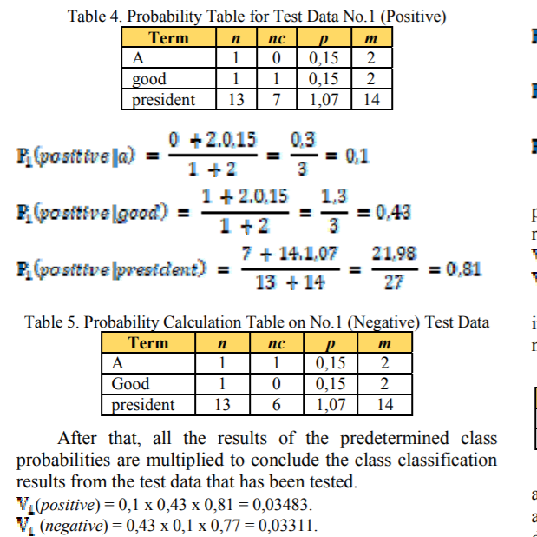


Experimental Results
Text preprocessing
Testing the data

Slide 11
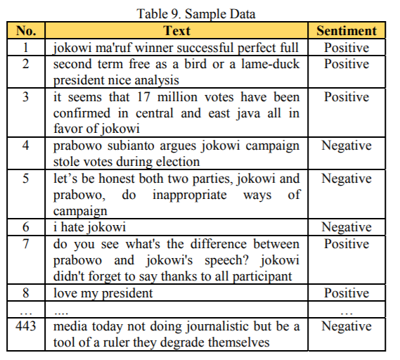
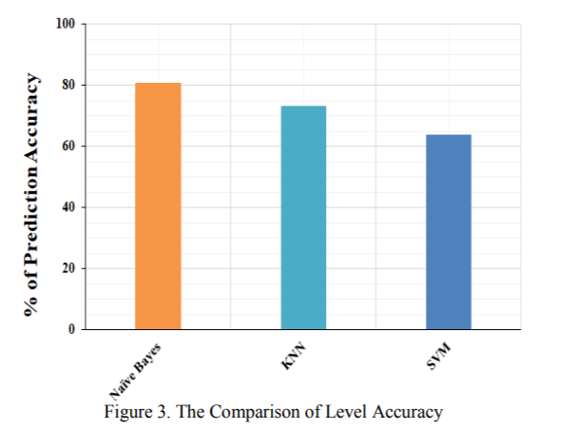
Performance Evaluation

Slide 12
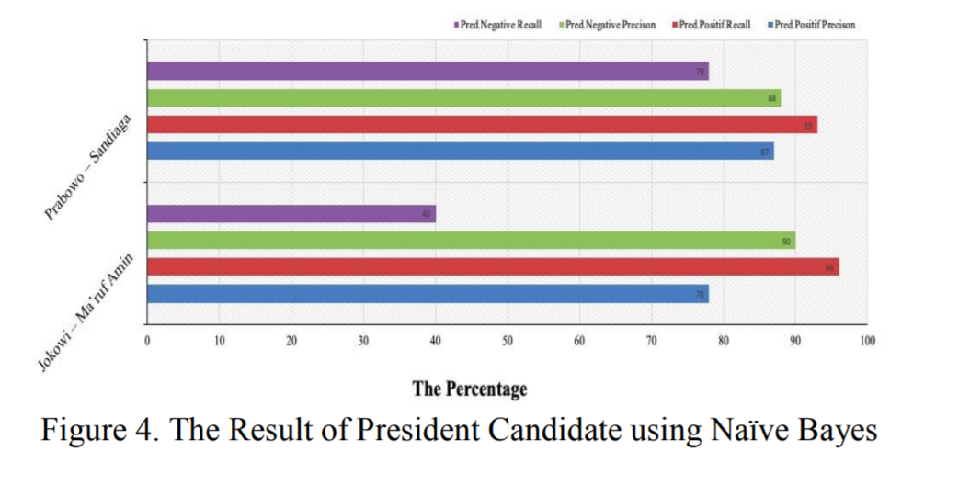

Slide 13
Conclusion
We discuss the sentiment analysis of public towards the Republic of Indonesia's presidential candidates for the 2019-2024 period, using tweet data obtained from social media: Twitter, by crawlers
Next we do the text processing from data obtained and use Naive Bayes method to predict the class
Afterward, compare with other methods such as SVM and KNN
It can be seen that the Naïve Bayes method has a better accuracy level than KNN and SVM methods.
We get the positive and negative sentiments of the respective presidential candidates

Slide 14
Implementation Strategy
Installation of:
Tweepy: tweepy is the python client for the official Twitter API
TextBlob: textblob is the python library for processing textual data
Crawling twitter using tweepy
Cleaning of data using textblob
Use of numpy and pandas for working on the data
Use of matplotlib to visualize the data
Use of scikit-learn module for the machine learning to do the predictions
Will be done on jupyter notebook or Google colab

Slide 15
References
https://monkeylearn.com/sentiment-analysis/
https://towardsdatascience.com/naive-bayes-classifier-81d512f50a7c
https://www.geeksforgeeks.org/twitter-sentiment-analysis-using-python/
https://monkeylearn.com/blog/practical-explanation-naive-bayes-classifier/

Slide 16
THANK YOU !

